Slide 1
Chapter-2
Language Reference

Slide 2
Introduction
We can develop two types of java programs:
Stand-alone applications:are programs written in Java to carry out certain tasks on a standalone local computer.
Executing a stand-alone Java program involves two steps:
Compiling source code into byte code using javac compiler.
Executing the bytecode program using java interpreter.
Web applets : Applets are small Java programs developed for Internet applications. An applet located on a distant computer (Server) can be downloaded via Internet and executed on a local computer (Client) using a Java-capable browser. We can develop applets for doing everything from simple animated graphics to complex games and utilities.
Stand-alone programs can read and write files and perform certain operations that applets cannot do.
An applet can only run within a Web browser.

Slide 3
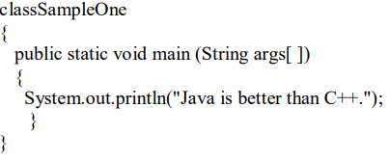
A simple Java program:
Class Declaration :The first line .
Class Sample One :Declares a class, which is an object-oriented construct.
class is a keyword and declares that a new class definition. SampleOne is a Java identifier.
Opening Brace: Every class definition in Java begins with an opening brace "{" and ends with a matching closing brace"}" appearing in the last line.
The main Line: The third line .

Slide 4
public static void main (String args[ ]) :
Defines a method named main. Every Java application program must include the main( ) method.
This is the starting point for the interpreter to begin the execution of the program.
This line contains a number of keywords, public, static and void.
The Output Line :
The only executable statement in the program is System.out.println("Java is better than C++.");
The println method prints the string Java is better than C++ to the screen.
Every Java statement must end with a semicolon.

Slide 5
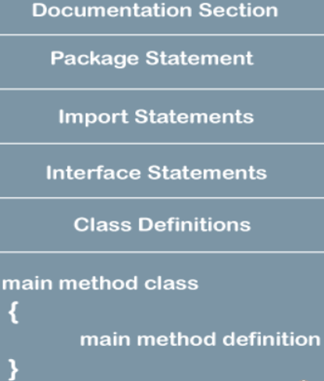
JAVA PROGRAM STRUCTURE:

Slide 6
JAVA PROGRAM STRUCTURE:
Documentation Section:
The documentation section comprises a set of comment lines giving the name of the program, the author and other details,.
Java permits both the single-line comments and multi-line comments.
The single-line comments begin with // and end at the end of the line.
multi-line comments begins with /* and ending with*/.
/**…............*/ known as documentation comment. This form of comment is used for generating documentation automatically.
Package Statement :
The first statement allowed in a Java file is a package statement.
This statement declares a package name and informs the compiler that the classes defined here belong to this package.
For example: package student; The package statement is optional.

Slide 7
Import Statements:
The next thing after a package statement (but before any class definitions) may be a number of import statements.
For example import student test. This statement instructs the interpreter to load the test class contained in the package student.
Interface Statements :
An interface is like a class but includes a group of method declarations.
This is also an optional section and is used only when we wish to implement the multiple inheritance features in the program.
Class Definitions:
A Java program may contain multiple class definitions. Classes are the primary and essential elements of a Java program.
Main Method Class :
Since every Java stand-alone program requires a main method as its starting point, this class is the essential part of a Java program.
A simple Java program may contain only this part.

Slide 8
JAVA TOKENS:
Smallest individual units in a program are known as tokens.
In simple terms, a Java program is a collection of tokens, comments and white spaces.
Java language includes five types of tokens. They are:
Keywords
Keywords are an essential part of a language definition. They implement specific features of the language.
Java language has reserved 60 words as keywords.
These keywords, combined with operators and separators according to syntax, form definition of the Java language
All keywords are to be written in lower-case letters.
Identifiers
Identifiers are programmer-designed tokens.
They are used for naming classes, methods, variables, objects, labels, packages and interfaces in a program.

Slide 9
Java identifiers follow the following rules:
They can have alphabets, digits, and the underscore and dollar sign characters.
They must not begin with a digit.
Uppercase and lowercase letters are distinct.
They can be of any length.
Literals :
Literals in Java are a sequence of characters (digits, letters, and other characters) that represent constant values to be stored in variables.
Java language specifies five major types of literals. They are:
Integer literals
Floating point literals
Character literals
String literals
Boolean literals

Slide 10
Operators :
An operator is a symbol that takes one or more arguments and operates on them to produce a result.
Separators:
Separators are symbols used to indicate where groups of code are divided and arranged.
They basically define the shape and function of our code.
Some of the separators are : parentheses( ), braces{ },brackets[ ], semicolon; comma , period.

Slide 11
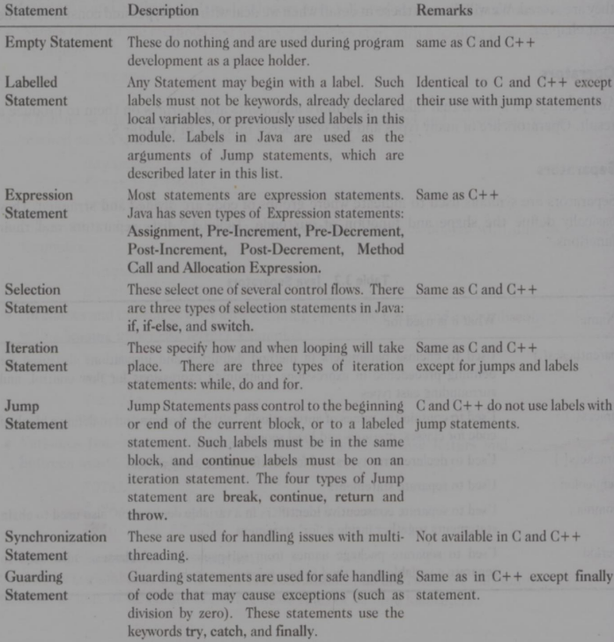
Java statements :
The statements in Java are like sentences in natural languages. A statement is an executable combination of tokens ending with a semicolon ( ; ) mark.

Slide 12
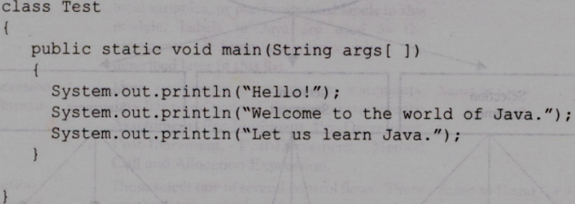
IMPLEMENTING A JAVAPROGRAM
Creating the program
Compiling the program
Running the program
Creating the Program:
We can create a program using any text editor. Assume that we have entered the following code
We must save this program in a file called Test.java ensuring that the filename contains the class name properly.
This file is called the source file. All Java source files will have the extension java.
If a program contains multiple classes, the file name must be the class name of the class containing the main method.

Slide 13
Compiling the Program:
To compile the program, we must run the Java Compiler javac, with the name of the source file on the command line
as javac Test.java . If everything is OK, the javac compiler creates a file called Test.class containing the bytecodes of the program. The compiler automatically names the bytecode file as .class
Running the Program :
We need to use the Java interpreter to run a stand-alone program. At the command prompt, type java Test. When executed program displays the following: Hello! Welcome to the world of Java. Let us learn Java.

Slide 14
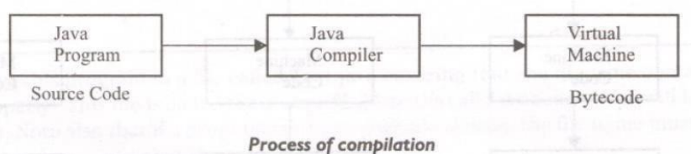
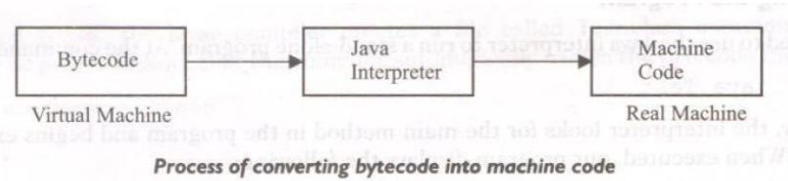
JAVA VIRTUAL MACHINE:
All language compilers translate source code into machine code for a specific computer. Java compiler also does the same thing.
The Java compiler produces an intermediate code known as bytecode for a machine that does not exist. This machine is called the Java Virtual Machine and it exists only inside the computer memory.
It is a simulated computer within the computer and does all major functions of a real computer.
The virtual machine code is not machine specific. The machine specific code known as machine code) is generated by the Java interpreter by acting as an intermediary between the virtual machine and the real machine.

Slide 15
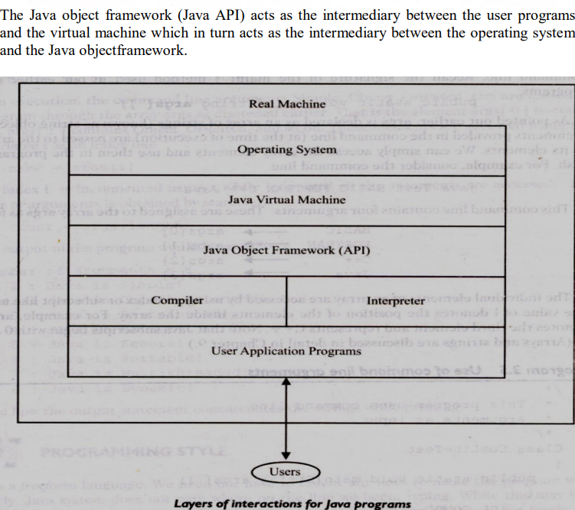

Slide 16
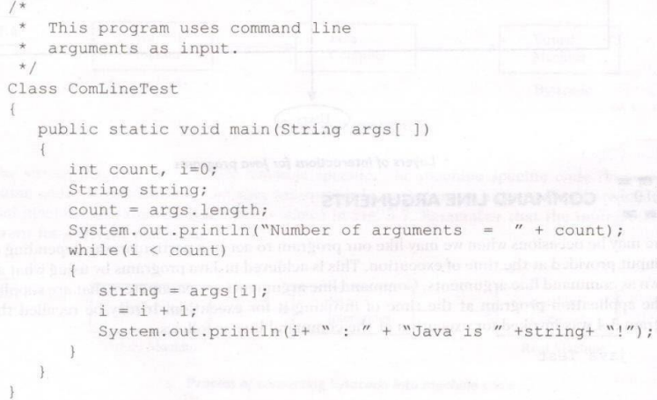
COMMAND LINE ARGUMENTS:
There may be occasions when we may like our program to act in a particular way depending on the input provided at the time of execution.
This is achieved in Java programs by using what are known as command line arguments.
Command line arguments are parameters that are supplied to the application program at the time of invoking it for execution.
We can write Java programs that can receive and use the arguments provided in the command line.

Slide 17
Compile and run the program with the command line as follows:
JavaComLineTest Simple Object_Oriented Distributed Robust Secure Portable Multithreaded Dynamic .
The number of arguments is obtained by statement count = args.length;
The output of the program would be as follows:
Number of arguments = 8
1 : Java is Simple!
2 : Java is Object_Oriented!
3 : Java is Distributed!
4 : Java is Robust!
5 : Java is Secure!
6 : Java is Portable!
7 : Java is Multithreaded!
8 : Java is Dynamic!
Note how the output statement concatenates the strings while printing.

Slide 18
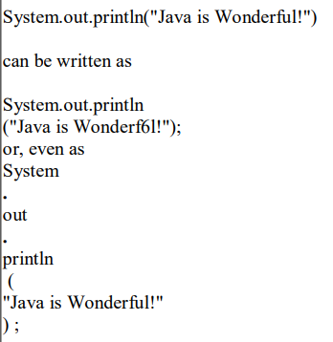
PROGRAMMING STYLE :
Java is a freeform language.
We need not have to indent any lines to make the program work properly.
Java system does not care where on the line we begin typing.
Example:

Slide 19
Constants variables and Data Types
CONSTANTS:
Constants in Java refer to fixed values that do not change during the execution of a program.
Integer Constants:An integer constant refers to a sequence of digits. There are three types of integers, namely, decimal integer, octal integer and hexadecimal integer .
Decimal integers consist of a set of digits, 0 through 9, preceded by an optional minus sign. Valid examples of decimal integer constants are: 123 -321 0 654321
An octal integer constant consists of any combination of digits from the set 0 through 7, with a leading O. Some examples of octal integer are: 037 0 0435 0551
A sequence of digits preceded by Ox or OX is considered as hexadecimal integer (hex integer). They may also include alphabets A through F or a through f. A letter A through F represents the numbers 10 through 15. Valid examples of hex integers are: OX2 OX9FOxbcdOx.

Slide 20
Real Constants
Integer numbers are inadequate to represent quantities that vary continuously, such as distances, heights, temperatures, prices, and so on. These quantities are represented by numbers containing fractional parts like 17.548. Such numbers are called real (or floating point) constants.
Examples : 0.0083 -0.75 435.36 These numbers are shown in decimal notation, having a whole number followed by a decimal point and the fractional part, which is an integer.
A real number may also be expressed in exponential (or scientific) notation. For example, the value 215.65 may be written as 2.1565e2 in exponential notation.
A floating point constant may thus comprise four parts:
(1)A whole number (2)A decimal point (3)A fractional part (4)An exponent
Single Character Constants:
A single character constant (or simply character constant) contains a single character enclosed within a pair of single quote marks.
Examples:'5' 'X' „;‟

Slide 21
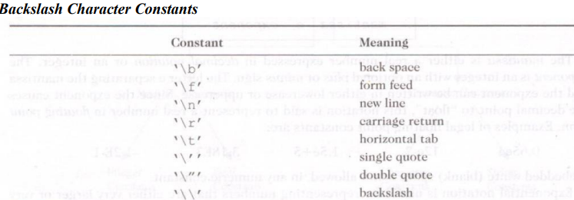
String Constants:
A string constant is a sequence of characters enclosed between double quotes.
The characters may be alphabets, digits, special characters and blank spaces.
Examples : "Hello Java" "1997" "WELL DONE" "?..!" "5+3""X“
Backslash Character Constants :
Java supports some special backslash character constants that are used in output methods.
For example, the symbol '\n' stands for newline character. Note that each one of them represents one character, although they consist of two characters. These characters combinations are known escape sequences.

Slide 22
Data Types :
Every variable in Java has a data type. Data types specify the size and type of values that can be stored.
Integer Types:
Integer types can hold whole numbers such as 123, -96, and 5639.
The size of the values that can be stored depends on the integer data type we choose.
Floating Point Types:
Integer types can hold only whole numbers so we use another type known as floating point type to hold numbers containing fractional parts such as 27.59 and -1.
Character Type:
In order to store character constants in memory, Java provides a character data type called char.
The char type assumes a size of 2 bytes but, basically, it can hold only a single character.
Boolean Type:
Boolean type is used when we want to test a particular condition during the execution of the program.
Two values that a boolean type can take: true or false.

Slide 23
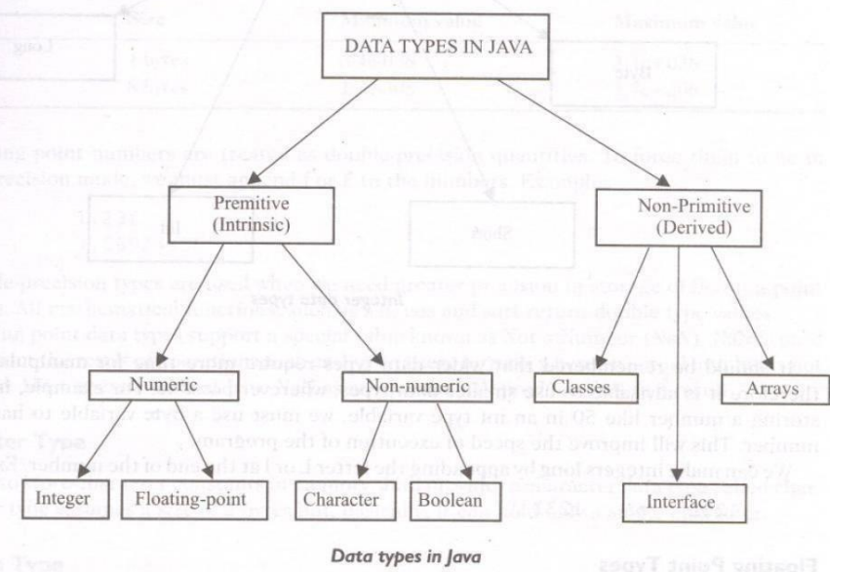

Slide 24
Variables:
A variable is an identifier that denotes a storage location used to store a data value. Unlike constants that remain unchanged during the execution of a program, a variable may take different values at different times during the execution of the program .
Variable names may consist of alphabets, digits, the underscore ( -) and dollar characters, subject to the following conditions:
They must not begin with a digit. 2.Uppercase and lowercase are distinct. 3.It should not be a keyword.
4. White space is not allowed. 5. Variable names can be of any length
Declaration Of variables:
Declaration does three things:
It tells the compiler what the variable name is.
It specifies what type of data the variable will hold.
The place of declaration (in the program) decides the scope of the variable.
The general form of declaration of a variableis: A variable must be declared before it is used in the program. A variable can be used to store a value of any data type.
Variables are separated by commas, A declaration statement must end with a semicolon.
Some valid declarations are: int count; float x, y; double pi;

Slide 25

GIVING VALUES TO VARIABLES
A variable must be given a value after it has been declared but before it is used in an expression. This can be achieved in two ways: 1. By using an assignmentstatement 2. By using a read statement Assignment Statement A simple method of giving value to a variable is through the assignment statement as follows
For example: initialValue = 0;
It is also possible to assign a value to a variable at the time of its declaration. This takes the form
For Example: intfinalvalue=100;
Read Statement We may also give values to variables interactively through the keyboard using the readLine().The readLine( ) method reads the input from the keyboard as a string which is then converted to the corresponding datatype.

Slide 26
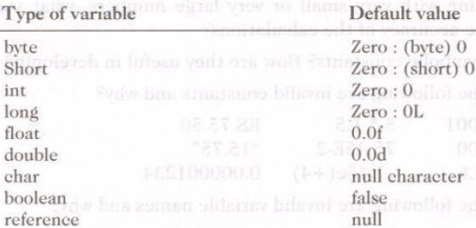
SCOPE OF VARIABLES
Java variables are actually classified into three kinds: instance variables class variables local variables Instance and class variables are declared inside a class. Instance variables are created when the objects are instantiated and therefore they are associated with the objects. They take different values for each object. On the other hand, class variables are' global to a class and belong to the entire set of objects that class creates. Only one memory location is created for each class variable. Variables declared and used inside methods are called local variables. They are called so because they are not available for use outside the method definition. Local variables can also be declared inside program blocks that are defined between an opening brace { and a closing brace }. These variables are visible to the program only from the beginning of its program block to the end of the program block. When the program control leaves a block, all the variables in the block will cease to exist. The area of the program where the variable is accessible is called its scope. In Java, every variable has a default value. If we don't initialize a variable when it is first created, Java provides default value to that variable type automatically.

Slide 27
SYMBOLIC CONSTANTS
We often use certain unique constants in a program. These constants may appear repeatedly in a number of places in the program.
One example of such a constant is 3.142, representing the value of the mathematical constant "pi". Another example is the total number of students whose mark-sheets are analysed by a 'test analysis program'. The number of students, say 50, may be used for calculating the class total, class average, standard deviation, etc. We face two problems in the subsequent use of such programs. Theyare: 1. Problem in modification of theprogram. 2. Problem in understanding theprogram.
Modifiability We may like to change the value of "pi" from 3.142 to 3.14159 to improve the accuracy of calculations or the number 50 to 100 to process the test results of another class. In both the cases, we will have to search throughout the program and explicitly change the value of the constant wherever it has been used. If any value is left unchanged, the program may produce disastrous outputs.
Understandability When a numeric value appears in a program, its use is not always clear, especially when the same value means different things in different places Valid examples of constant declaration are: Final int STRENGTH = 100; final int PASS MARK = 50;

Slide 28
Note that: 1. Symbolic names take the same form as variable names. 2. After declaration of symbolic constants, they should not be assigned any other value within the program by using an assignment statement. For example, STRENGTH = 200; is illegal. 3. Symbolic constants are declared for types. 4. They can NOT be declared inside a method

Slide 29
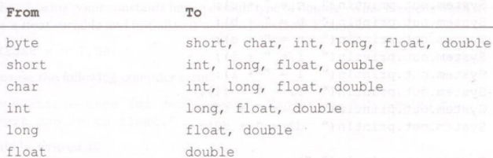
TYPECASTING We often encounter situations where there is a need to store a value of one type into a variable of another type. In such situations, we must cast the value to be stored by proceeding it with the type name in parentheses. The syntaxis:
The process of converting one data type to another is called casting. Four integer types can be cast to any other type except boolean. Casting into a smaller type may result in a loss of data. Similarly, the float and double can be cast to any other type except boolean. Again, casting to smaller type can result in a loss of data. Casting a floating point value to an integer will result in a loss of the fractional part. The process of assigning a smaller type to a larger one is known as widening or promotion and that of assigning a larger type to a smaller one is known as narrowing. Note that narrowing may result in loss ofinformation.

Slide 30
Automatic Conversion For some types, it is possible to assign a value of one type to a variable of a different type without a cast. Java does the conversion of the assigned value automatically. This is known as automatic type conversion. Automatic type conversion is possible only if the destination type has enough precision to store the source value. For example, int is large enough to hold a bytevalue. Therefore, byteb= 75; inta = b; are validstatements. The final result of an expression is converted to the type of the variable on the left of the assignment sign before assigning the value to it. However, the following changes are introduced during the final assignment. 1. float to int causes truncation of the fractionalpart. 2. double to float Causes rounding ofdigits. 3. long to int causes dropping of the excess higher orderbits

Slide 31
GETTING VALUES OF VARIABLES A computer program is written to manipulate a given set of data and to display or print the results. Java supports two output methods that can be used to send the results to the screen. print ( ) method / / print and wait println( ) method / / print a line and move to next line The print() method sends information into a buffer. This buffer is not flushed until a newline (or end-of-line) character is sent. As a result, the print() method prints output on one line until a newline character is encountered. For example, the statements System.out.print("Hello "); System.out.print("Java!"); It display the words Hello Java! on one line and waits for displaying further information on the same line. We may force the display to be brought to the next line. by printing a newline character as shown below: System.out.print('\n'); For example, the statements System.out.print(ftHello"); System.out.print(\n"); System.out.print(Java!"); It will display the output in two lines as follows: Hello Java!

Slide 32
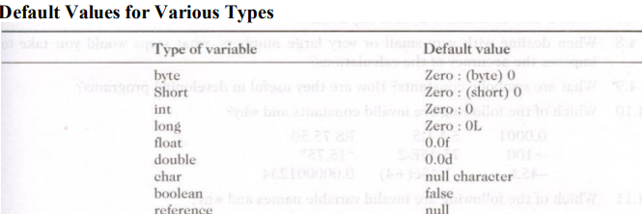
STANDARD DEFAULT VALUES In Java, every variable has a default value. If we don't initialize a variable when it is first created, Java provides default value to that variable type automatically.

Slide 33
Operators andExpressions Introduction Java supports a rich set of operators. Operator is a symbol that tells the computer to perform certain mathematical or logical manipulations. Operators are used in programs to manipulate data and variables. They usually form a part of mathematical or logical expressions. Java operators can be classified into a number of related categories as below: 1. Arithmeticoperators 2. Relationaloperators 3. Logicaloperators 4. Assignmentoperators 5. Increment and decrementoperators 6. Conditionaloperators. 7. Bitwiseoperators 8. Specialoperators

Slide 34
ARITHMETIC OPERATORS
Java provides all the basic arithmetic operators. These can operate on any built-in numeric data type of Java. We cannot use these operators on boolean type Arithmetic operators are used as shown below: a-b a*b a%b a+b a/b -a*b Here a and b may be variables or constants and are known as operands.
Arithmetic operators are used as shown below:
a-b a*b a%b a+b a/b -a*b
Here a and b may be variables or constants and are known asoperands.
Integer Arithmetic When both the operands in a single arithmetic expression such as a+ b are integers, the expression is called an integer expression, and the operation is called integer arithmetic. Integer arithmetic always yields an integer value Real Arithmetic An arithmetic operation involving only real operands is called real arithmetic. A real operand may assume values either in decimal or exponential notation. Since floating point values are rounded to the number of significant digits permissible, the final value is an approximation of the correct result. . Mixed-mode Arithmetic When one of the operands is real and the other is integer, the expression is called a mixedmode arithmetic expression. If either operand is of the real type, then the other operand is converted to real and the real arithmetic is performed. The result will be a real.

Slide 35
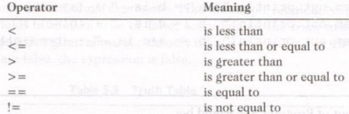
RELATIONALOPERATORS We often compare two quantities, and depending on their relation, take certain decisions. For example, we may compare the age of two persons, or the price of two items, and so on. These comparisons can be done with the help of relational operators.
Relational Operators
A simple relational expression contains only one relational operator and is of the following form: ae-land ae~2 are arithmetic expressions, which may be simple constants, variables or combination of them

Slide 36
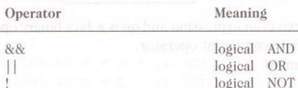
LOGICAL OPERATORS
In addition to the relational operators, Java has three logical operators,
The logical operators && and | | are used when we want to form compound conditions by combining two or more relations. An example is: a > b && x 10 An expression of this kind which combines two or more relational expressions is termed as a logical expression or a compound relational expression. Like the simple relational expressions. Logical expression also yields a value of true or false.
ASSIGNMENT OPERATORS Assignment operators are used to assign the value of an expression to a variable.
assignment operator = .
In addition, Java has a set of 'shorthand' assignment operators which are used in the form
The use of shorthand assignment operators has three advantages: 1. What appears on the left-hand side need not be repeated and therefore it becomes easier to write. 2. The statement is more concise and easier toread. 3. Use of shorthand operator results in a more efficientcode

Slide 37
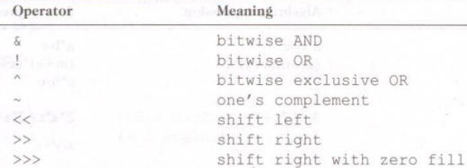
INCREMENT AND DECREMENTOPERATORS Java has two very useful operators not generally found in many other languages. These are the increment and decrement operators: ++ and—. The operator + + adds 1 to the operand while - - subtracts 1. Both are unary operators and are used in the following form. ++m; or m++; is equivalent to m = m + 1; --In; or m--; is equivalent to m = m - 1;
CONDITIONAL OPERATOR The character pair ?: is a ternary operator available in Java. This operator is used to construct conditional expressions of the form
Where expl, exp2, and exp3 are expressions.
BITWISE OPERATORS
Java has a distinction of supporting special operators known as bitwise operators for manipulation of data at values of bit level.
SPECIAL OPERATORS Java supports some special operators of interest such as instance of operator and member selection operator(.).

Slide 38
Instance of Operator
The instance of is an object reference operator and returns true if the object on the left-hand side is an instance of the class given on the right-hand side. This operator allows us to determine whether the object belongs to a particular class or not. Example: person instanceof student is true if the object person belongs to the class student; otherwise it is false. Dot Operator The dot operator (.) is used to access the instance variables and methods of class objects. Examples: person1.age //Reference to the variable age person1.salary( ) //Reference to the method salary( ) It is also used to access classes and sub-packages from a package

Slide 39
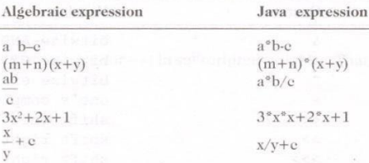
ARITHMETICEXPRESSIONS
An arithmetic expression is a combination of variables, constants, and operators arranged as per the syntax of the language. Java can handle any complex mathematical expressions.
EVALUATIONOF EXPRESSIONS
Expressions are evaluated using an assignment statement of the form
Variable is any valid Java variable name. When the statement is encountered, the expression is evaluated first and the result then replaces the previous value of the variable on the left- hand side. All variables used in the expression must be assigned values before evaluation is attempted. Examples of evaluation statements are x= a*b-c; y = b/c*a; z= a-b/c+d;

Slide 40
OPERATOR PRECEDENCE ANDASSOCIATIVITY Each operator in Java has a precedence associated with it. This precedence is used to determine how an expression involving more than one operator is evaluated. There are distinct levels of precedence and an operator may belong to one of the levels. The operators at the higher level of precedence are evaluated first. The operators of the same precedence are evaluated either from left to right or from right to left, depending on the level. This is known as the associativity property of an operator

